Slide 1

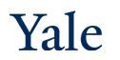
Deep Learning Theory and Applications Representation Learning in Neural Networks
CPSC/AMTH 663

Slide 2
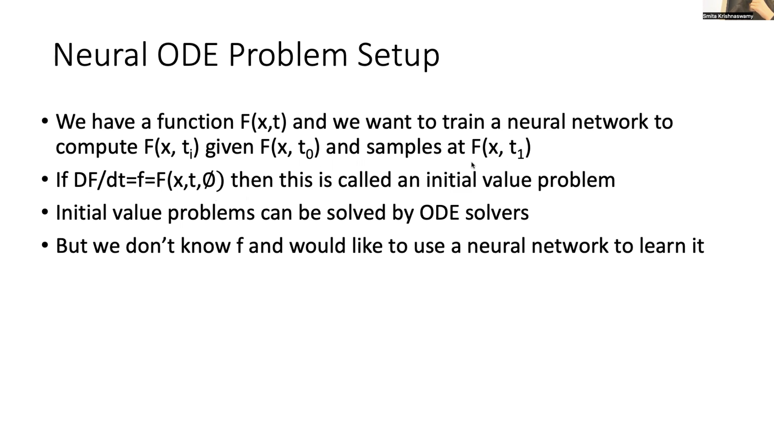

Slide 3
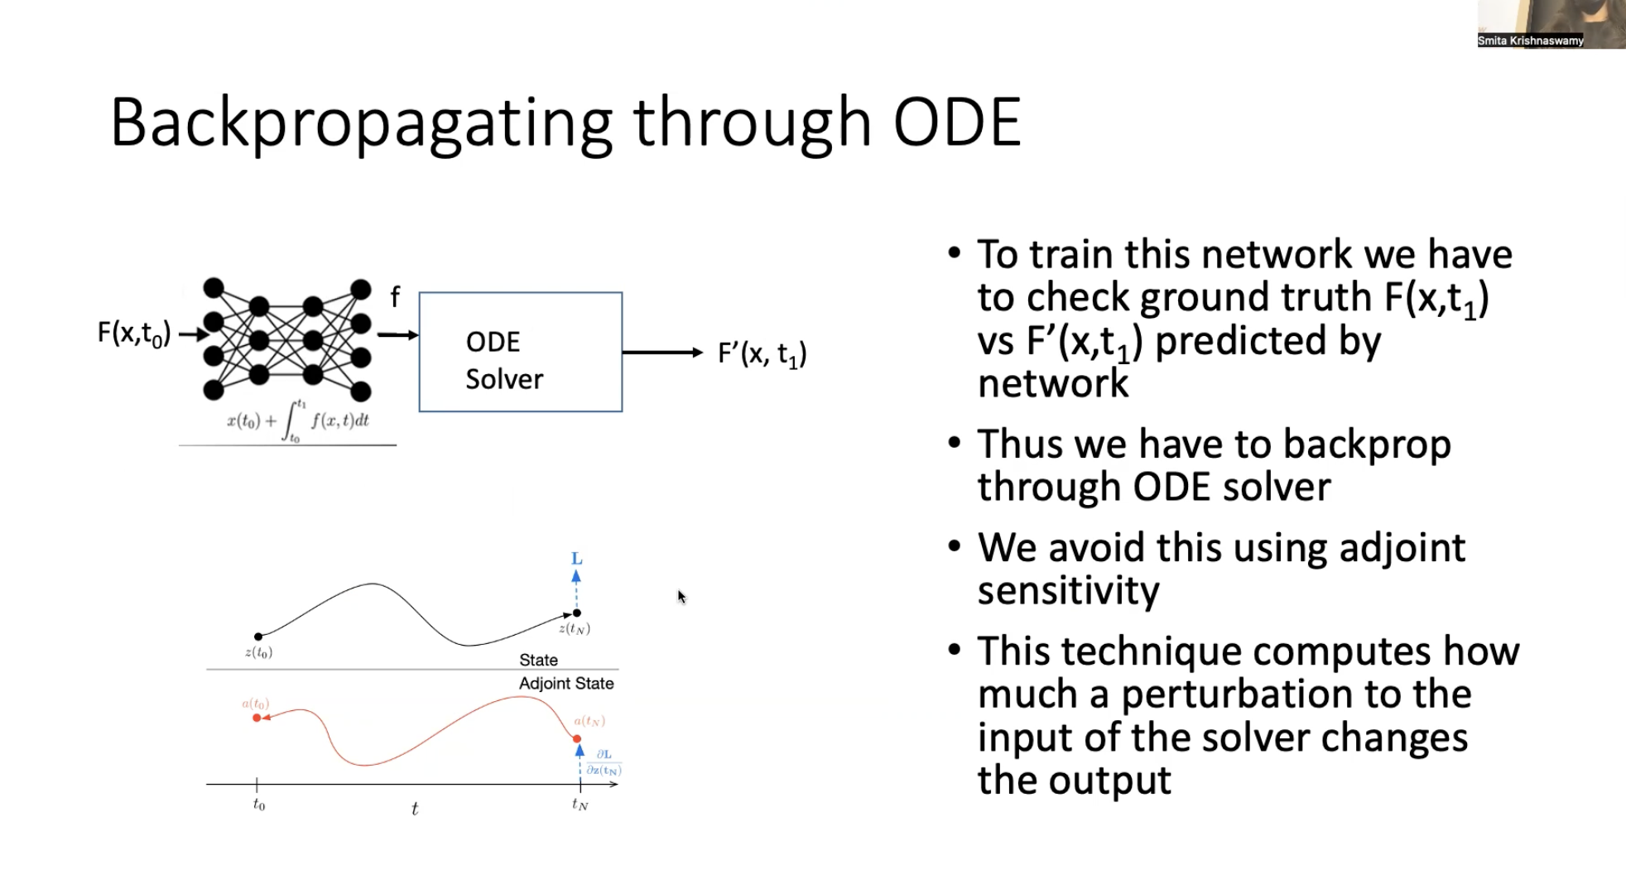
design a NN to compute derivative f
predicted t1 value
input t0
backpropagate the loss through ODE Solver and network use adjoint sensitivity
skip backpropagate ODE Solver bc we don’t care training params in the ODE Solver
we only care about training params in the neural net
adjoint sensitivity looks at stability
ODE Solver can sample any time points
by integrating the derivative f

Slide 4
What is happening inside a neural network?
The output of a neural network is a function
We learned last time that it can be ANY function
Should be able to approximate it
Now what about the other layers?
How are they facilitating the learning?

Slide 5
Dimensionality Reduction
Neural networks typically learn a dimensionality reduced embedding in their internal layers
These embeddings form GOOD projections of the data
Projections that maintain distances between datapoints
Projections that can show groupings, clusters etc
This can be shown mathematically

Slide 6
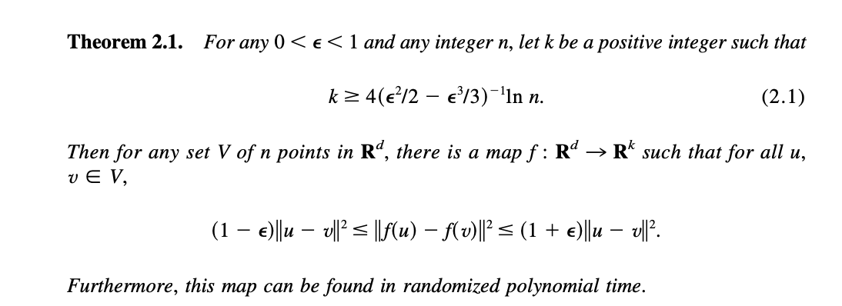
Johnson Lindenstrauss Lemma

Slide 7
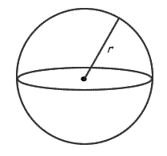
Length of projected unit vector
What is the expected length of a unit vector in d dimensions when it is projected down to K?
If several such vectors are projected down would their relative magnitudes be preserved?

Slide 8
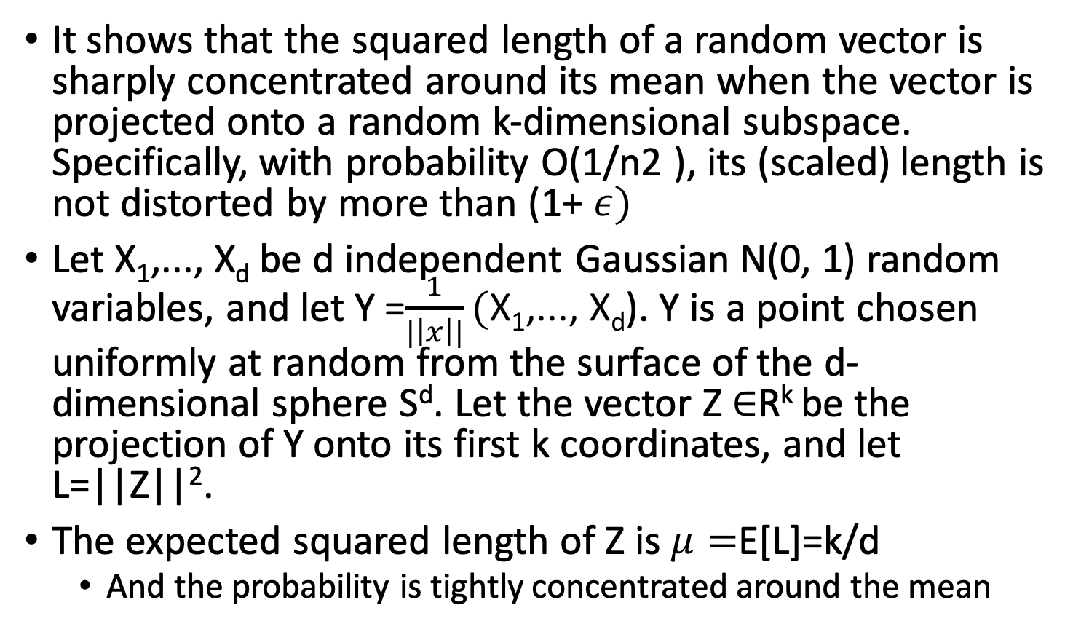
Proof Concept
It shows that the squared length of a random vector is sharply concentrated around its mean when the vector is projected onto a random k-dimensional subspace. Specifically, with probability O(1/n2 ), its (scaled) length is not distorted by more than (1+ $ε)$
Let X₁,..., X_{d} be d independent Gaussian N(0, 1) random variables, and let Y =$\frac{1}{|\left|x\right||}(\text{X}\text{1}\text{,..., }\text{Xd}$). Y is a point chosen uniformly at random from the surface of the d-dimensional sphere S^{d}. Let the vector Z $∈$R^{k} be the projection of Y onto its first k coordinates, and let L=||Z||².
The expected squared length of Z is $μ=$E[L]=k/d
And the probability is tightly concentrated around the mean

Slide 9
Johnson-Lindenstrauss lemma
How does this connect to neural networks?
This means that random initialization helps find good results, local minima are pretty good
High probability of cluster patterns, manifolds, existing
SGD will only improve upon it.
Notes:
Note that there aren’t any formal arguments here but rather some interesting possible connections/conjecture

Slide 10
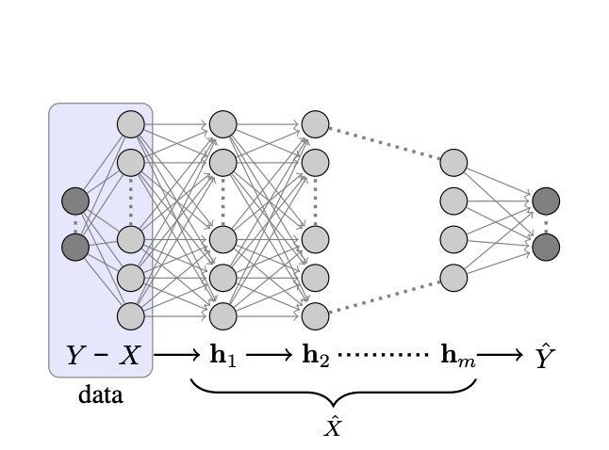
Deep Projections
We have projections, but why make them deep?
What do subsequent layers do?

Slide 11
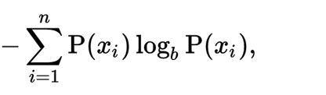
Entropy as a measure of uncertainty
Y Spread
in X-Slice
Y Spread
Measure of Uncertainty in a random variable.
X-Slice
Units of bits tells us how many bits are needed to represent the outcome
Notes:
At its core mutual information determines how the spread of a variable Y decreases as you condition on another variables X. But mutual information works when there is an even samplign along the dynamic range.

Slide 12

Mutual Information
Y Spread
in X-Slice
Y Spread
X-Slice
Mutual Information: I(X,Y) = H(Y) –H(Y|X)
Notes:
At its core mutual information determines how the spread of a variable Y decreases as you condition on another variables X. But mutual information works when there is an even samplign along the dynamic range.

Slide 13
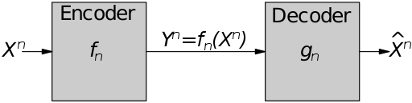
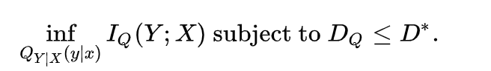
Rate Distortion Theory

Slide 14
Information Bottleneck Principle
Introduced by Tishby et al. uses information theory to understand what about the input is relevant to the output
Given a joint distribution p(X,Y), the information relevant to Y within X is given by I(X,Y) the mutual information between X and Y
Therefore, a good compression of X should capture the mutual information and discard the remaining information

Slide 15
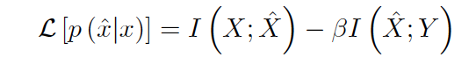
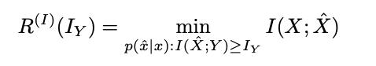
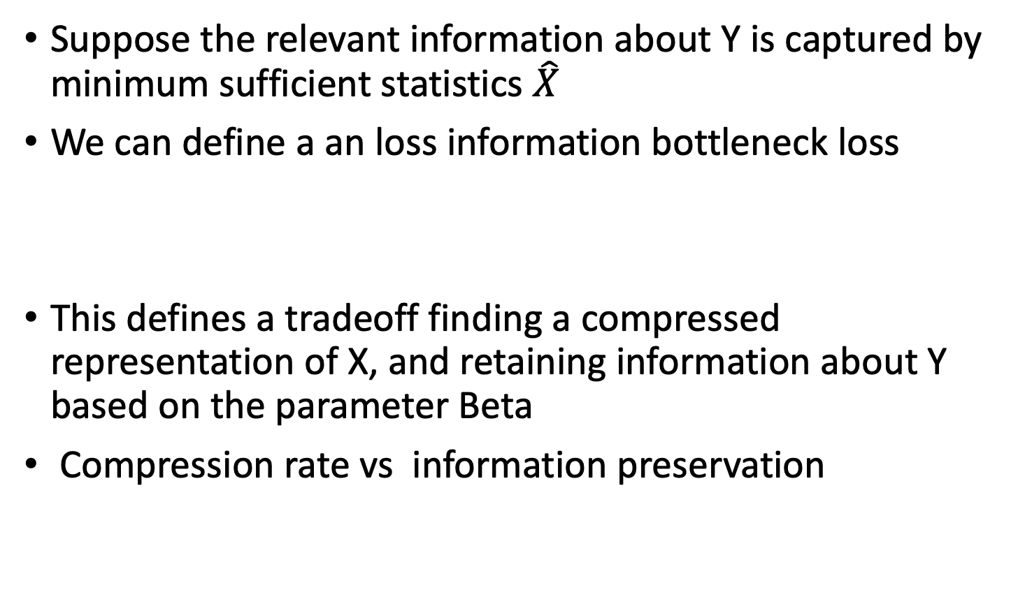
Information Bottleneck Loss
Suppose the relevant information about Y is captured by minimum sufficient statistics $\hat{X}$
We can define a an loss information bottleneck loss
This defines a tradeoff finding a compressed representation of X, and retaining information about Y based on the parameter Beta
Compression rate vs information preservation

Slide 16
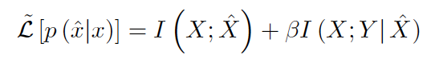
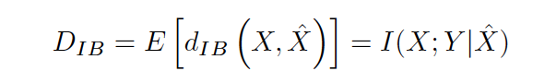

IB Loss
The information bottleneck loss can be written as (only differ by constant)
With this you can define a distortion
Distortion is the expected Kullback-Liebler divergence

Slide 17
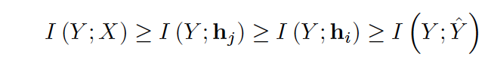
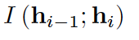
DNNs as Markov Chains
DNNs use multiple internal layers to compress representations
These can be thought of Markov Chains and reasoning about them can be done via the Data Processing Inequality
Achieving equality only happens when maximizing information to the output layer but also minimizing as much as possible information between subsequent layers

Slide 18
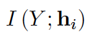
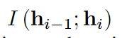
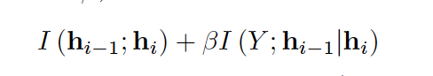
Relevant quantities
It has been shown that can bound classification error in tasks with multiple classes
This is the mutual information between the representation in layer i and the class labels in Y
This is the minimal description length
Each layer can be compared to the theoretical optimal layer for the loss

Slide 19
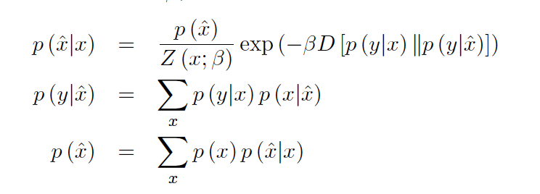
Optimal Solutions for IB Loss
Can be found by iterating these equations
This gives rise to an optimal rate distortion curve (not one that is reached by DNNs)

Slide 20
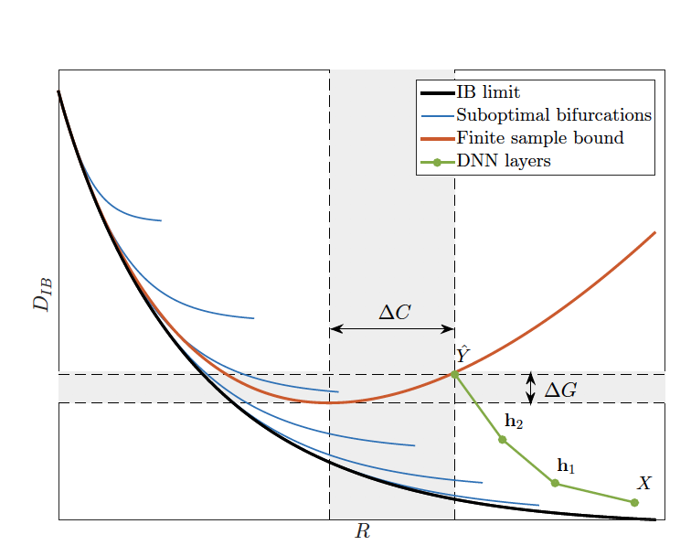
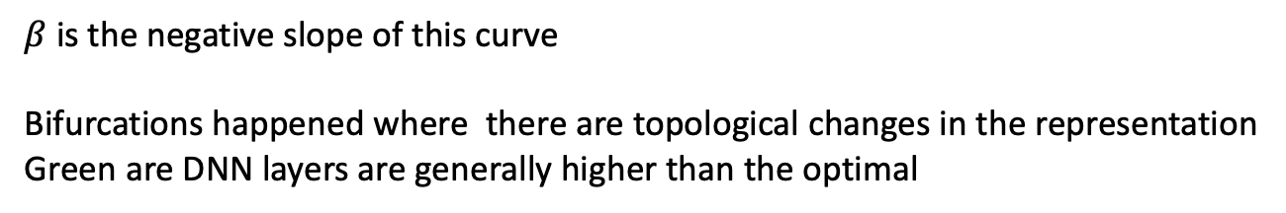
Rate Distortion Curve
$β$is the negative slope of this curve
Bifurcations happened where there are topological changes in the representation
Green are DNN layers are generally higher than the optimal

Slide 21
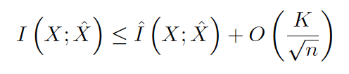
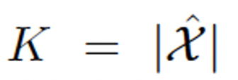
Multiple DNN Layers
Each layer can only increase the distortion (based on data processing inequality)----can’t add lost information
However layers can compress information better in order to meet the finite sample bound curve
This is the bound you can get using only a finite sample

Slide 22
IB-based Reason for Multiple Layers
Each layer in a neural network effectively only linearly seperates the information in the pervious layer
Recall: One layer neural networks are equivalent to SVMs
This is because layers are non-linear functions of dot products
Linear separability is only possible when input units are conditionally independent given output classification
This this is not necessarily true of the data distribution, multiple hidden layers are required!

Slide 23
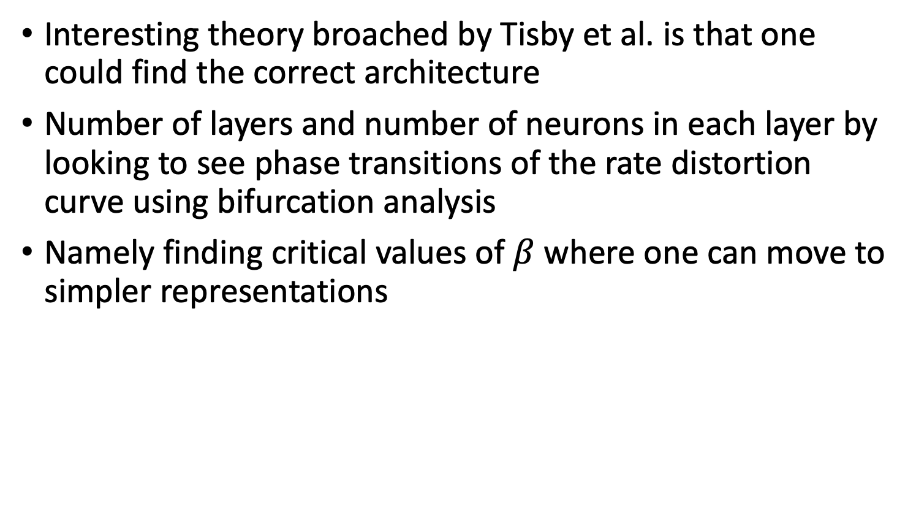
Phase Transitions
Interesting theory broached by Tisby et al. is that one could find the correct architecture
Number of layers and number of neurons in each layer by looking to see phase transitions of the rate distortion curve using bifurcation analysis
Namely finding critical values of $β$ where one can move to simpler representations

Slide 24
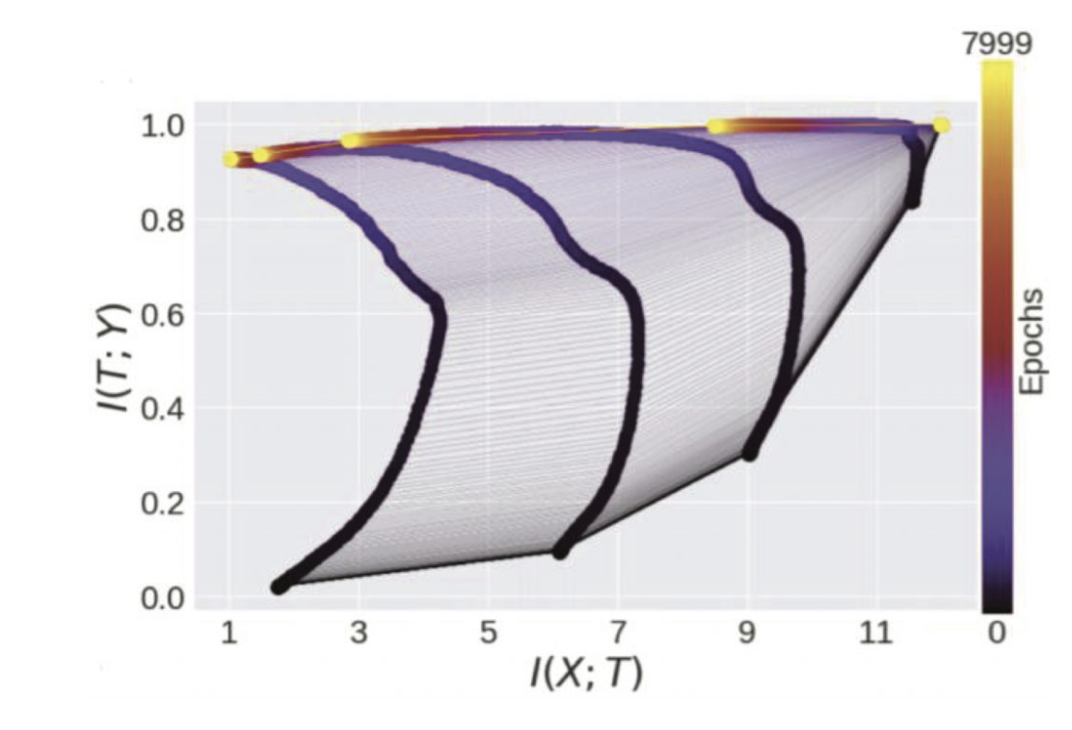
During Training
It has been observed that the mutual information between the input layer and the hidden layers initially increases as the neural network learns to encode the input
Then falls rapidly as it learns to compress this information

Slide 25
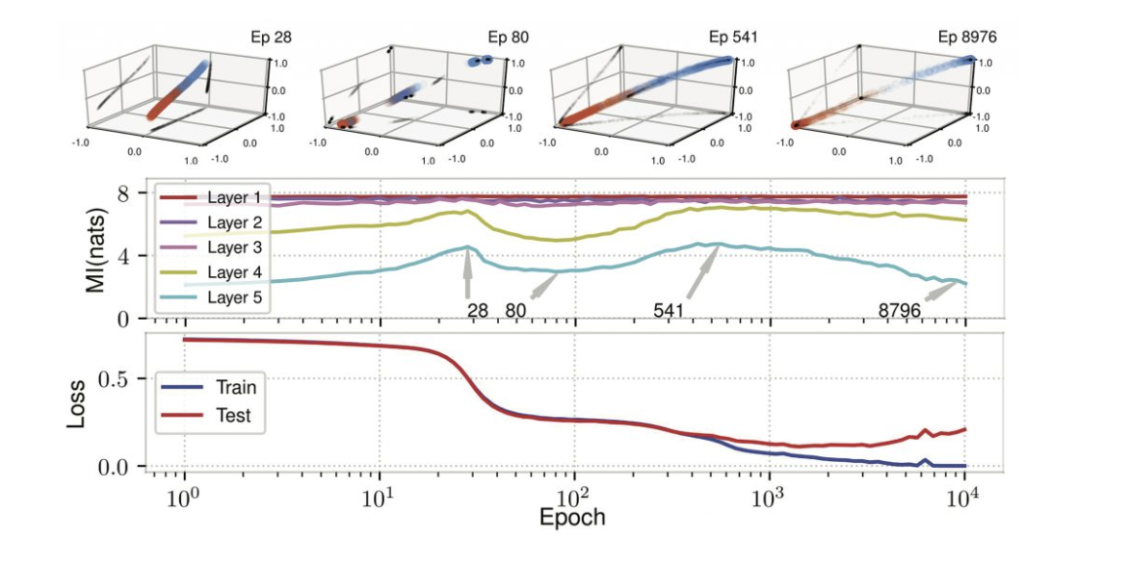
Evolution of representation
Rise and fall of MI corresponds to how clustered the representation will be

Slide 26
How do representations evolve?
What happens during training
We have shown that random initializations start well where do they go after training?

Slide 27



M-PHATE Visualizing Internal Representations (Gigante,S. et al. NeurIPS 2019)
Scott Gigante
Gal Mishne
Scott Gigante
Adam Charles
Gal Mishne
Main idea: Multi-slice kernel allows for PHATE to visualize dynamic behaviorin neural networks

Slide 28
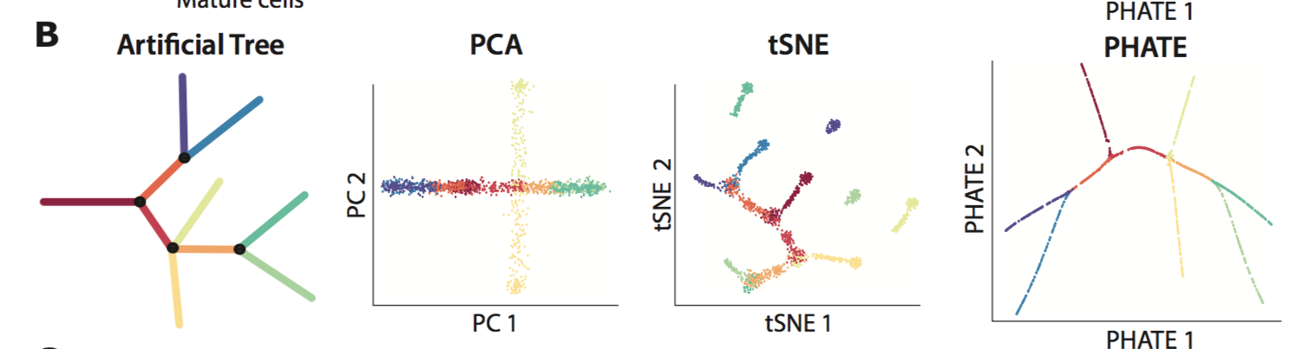
Visualization methods fail to capture global structure in high dimensional data

Slide 30
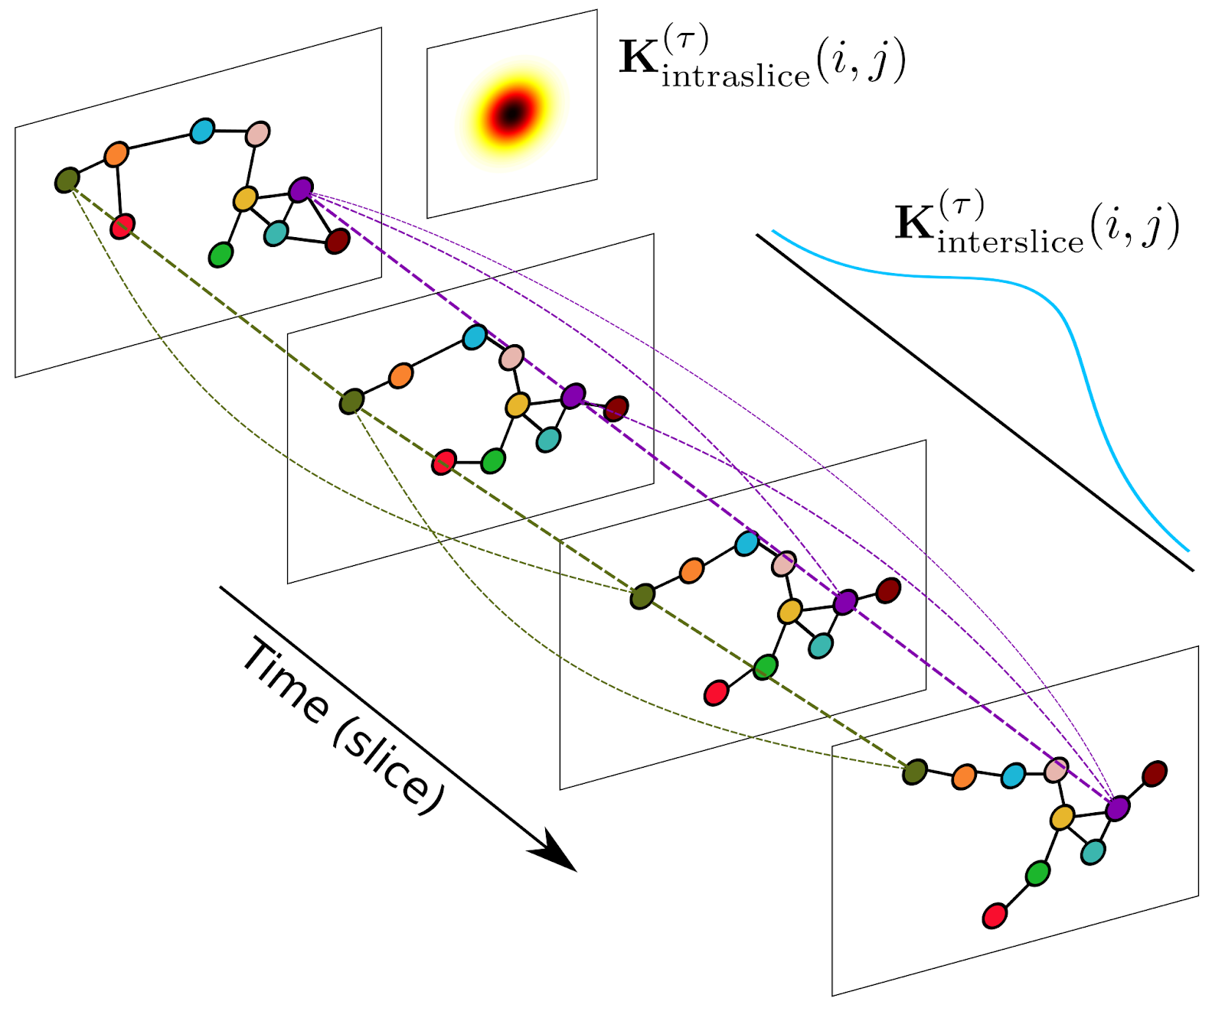
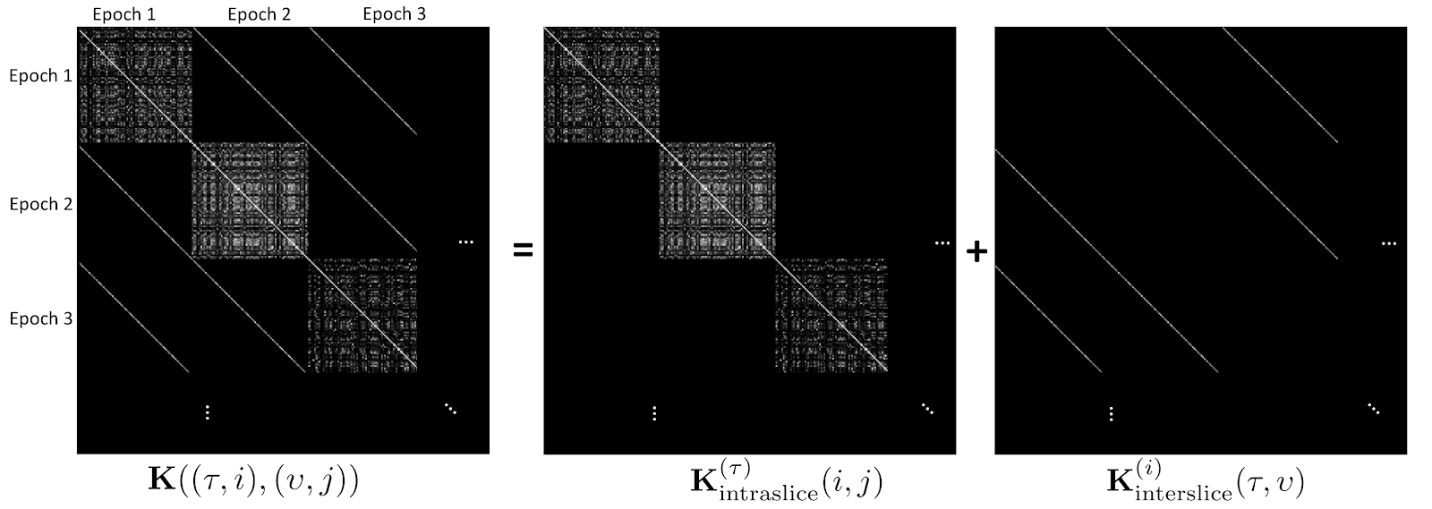
M-PHATE Neural Network Learning

Slide 31
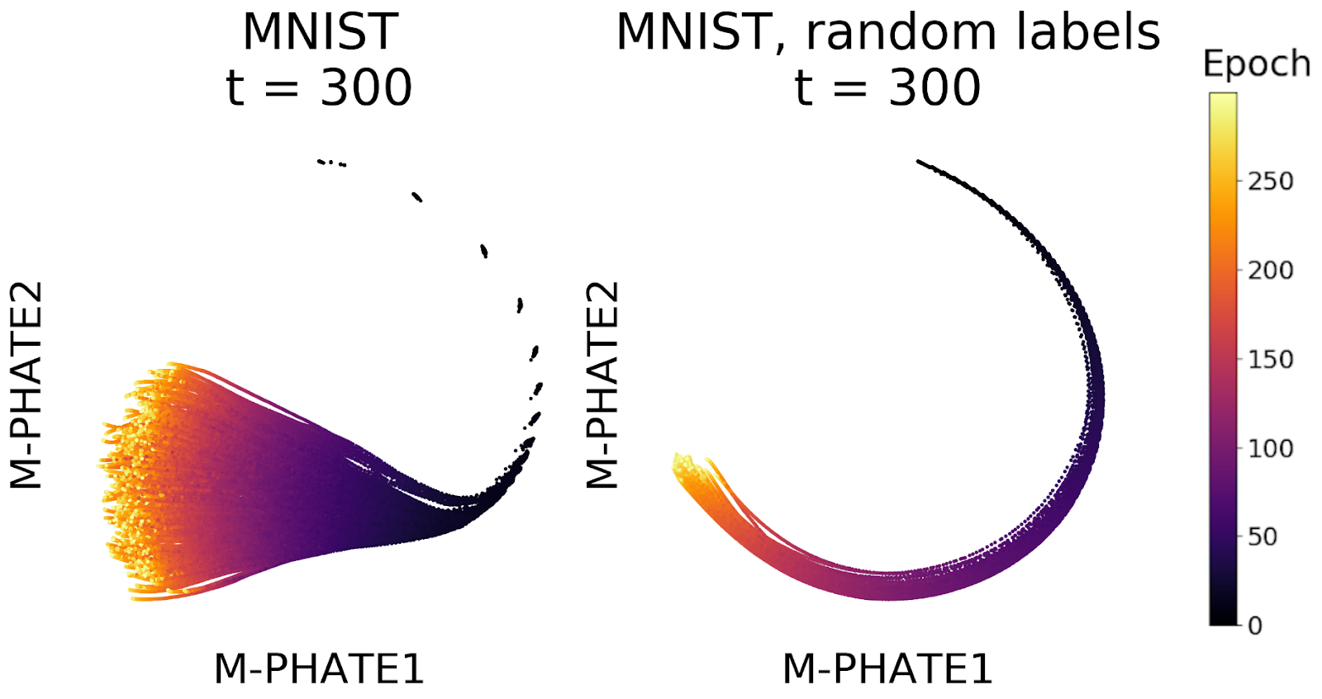
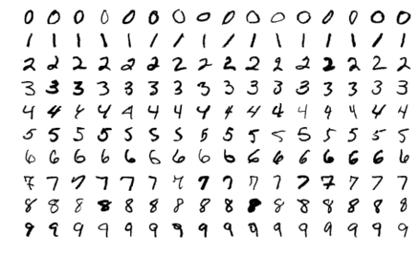
Learning vs Memorization in Nnets
Mnist handwritten digits

Slide 32
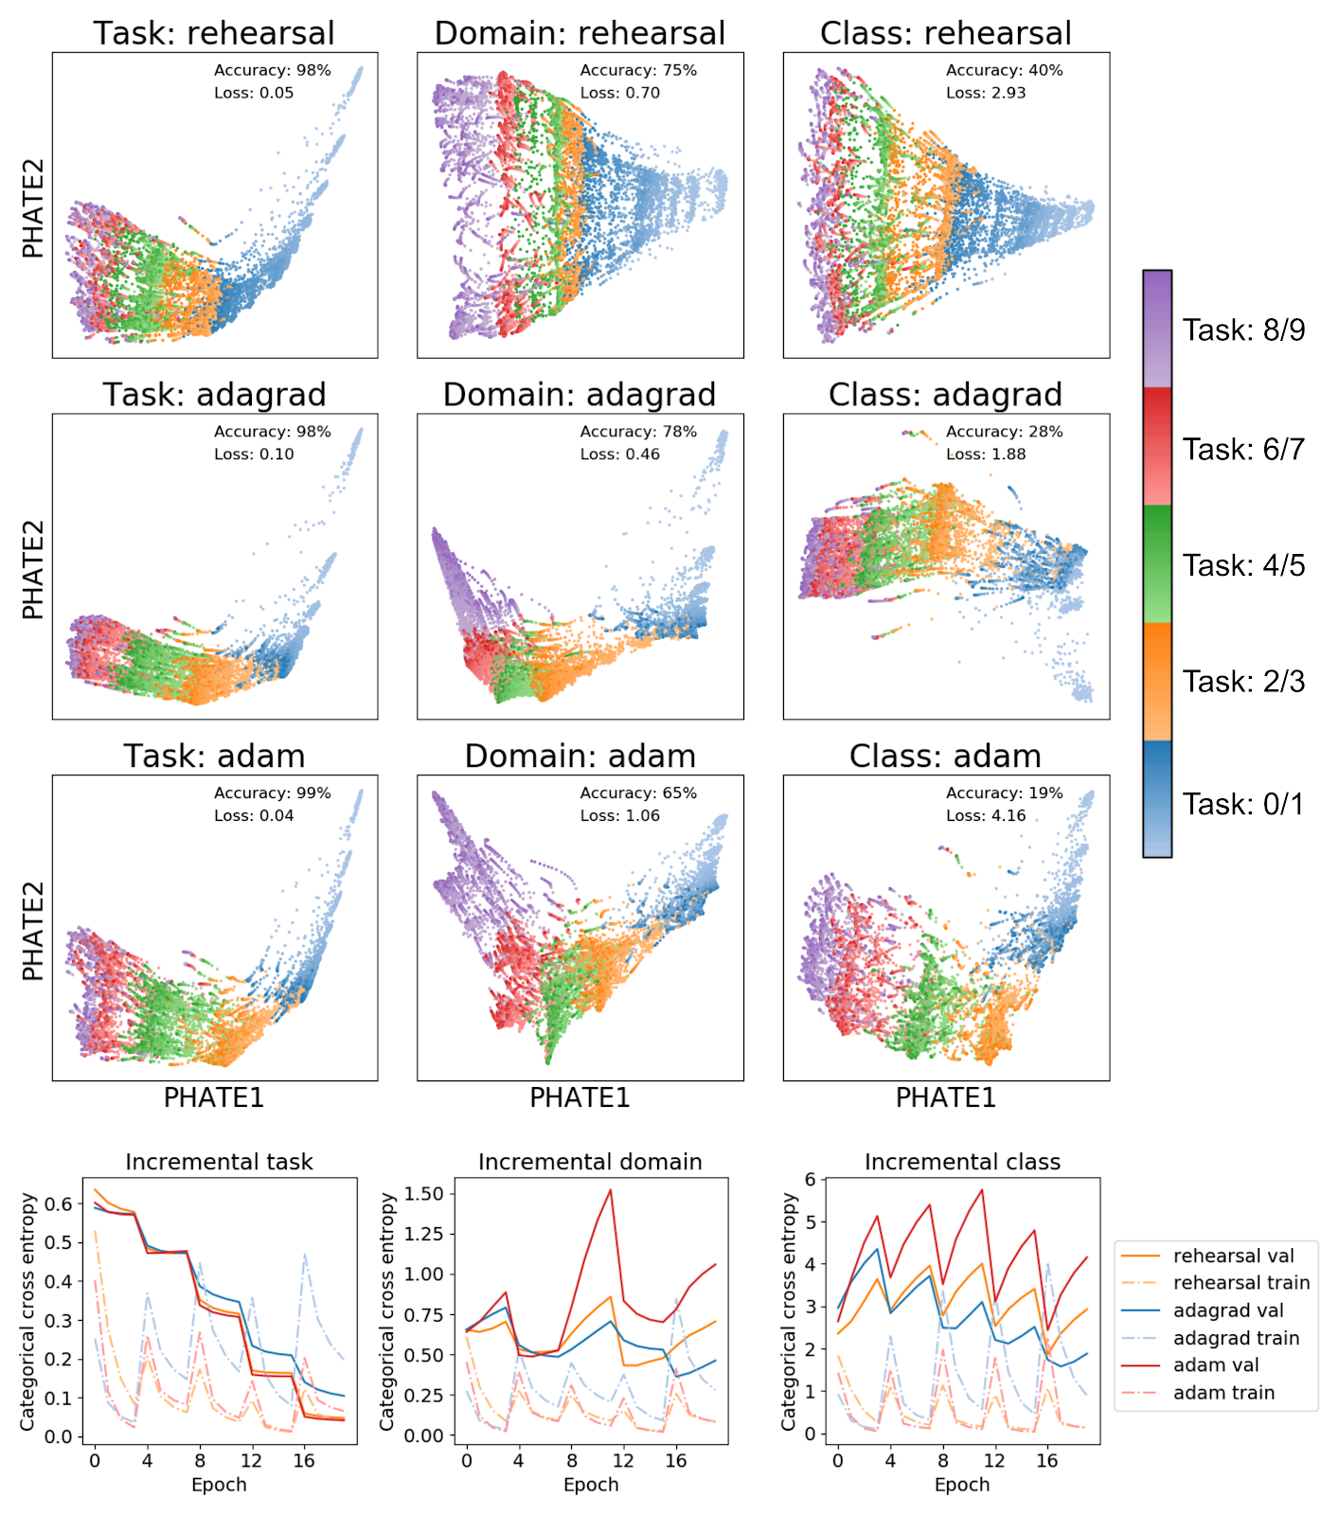
Learning vs. Catastrophic Forgetting

Slide 33
Expanding and shrinking
We have shown that we can use depth to increase the power of a neural network
Can we also shrink or prune a network?
There could be many reasons to shrink or prune a network

Slide 34

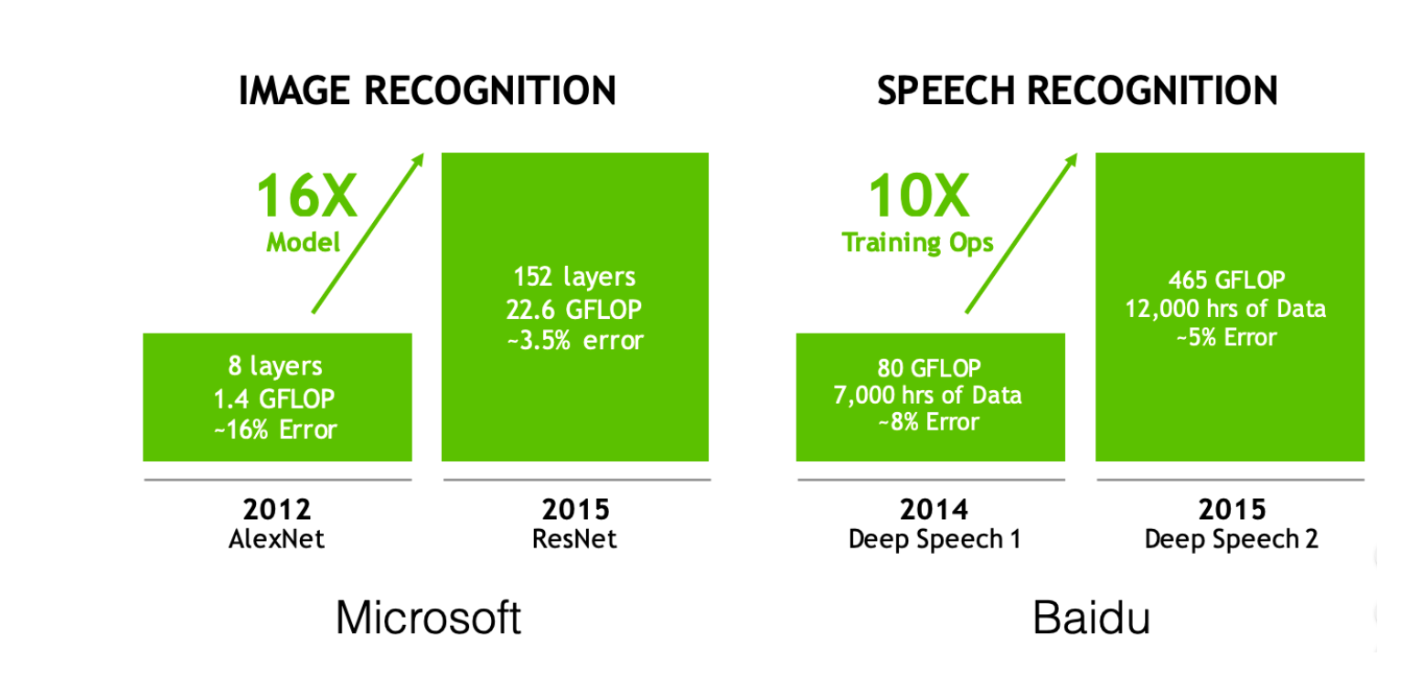
Reducing Model Size

Slide 35
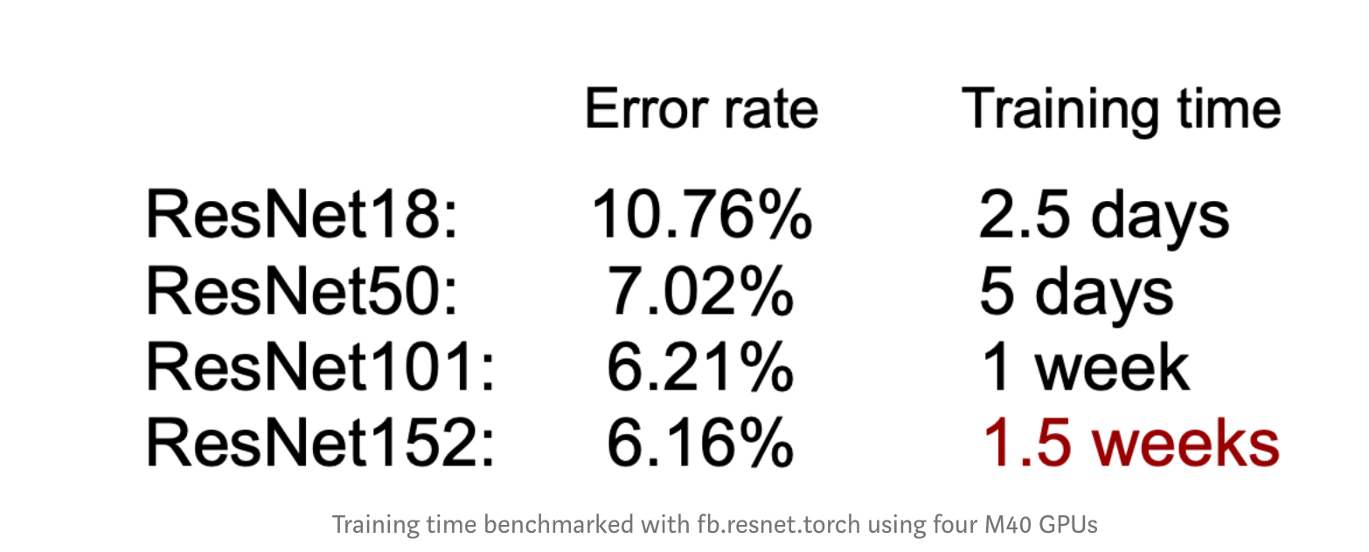
Difficulty Training Large Models

Slide 36
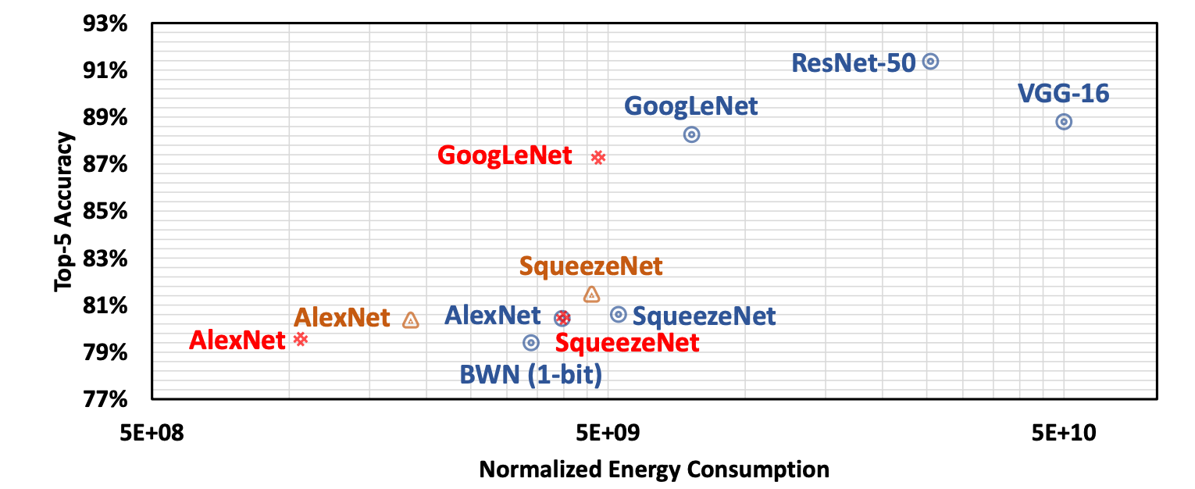
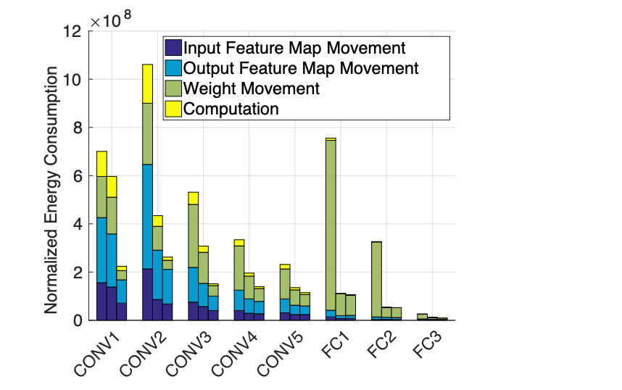
Energy consumption

Slide 37
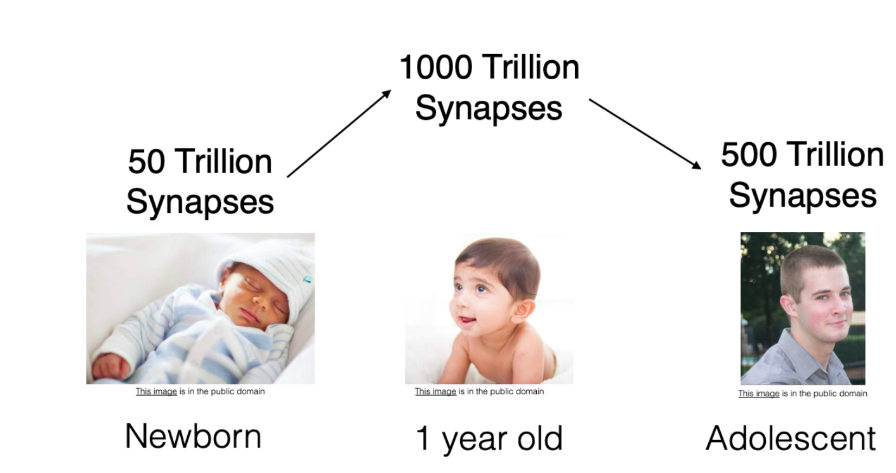
Biological Inspiration for Pruning

Slide 38
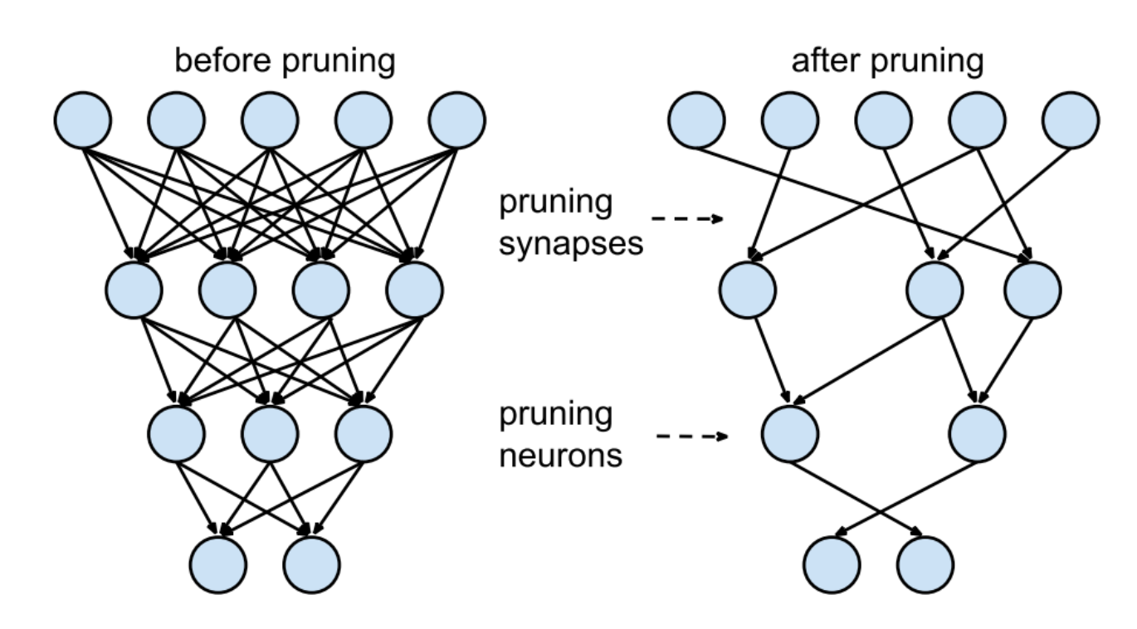
Neural Network Pruning

Slide 39
Weight Pruning
Set individual weights in the weight matrix to zero. This corresponds to deleting connections
To achieve k% sparsity rank the individual weights in weight matrix W according to their magnitude, and then set the smallest k% to zero.

Slide 40
Neuron Pruning
Set entire columns to zero in the weight matrix to zero, in effect deleting the corresponding output neuron.
Here to achieve sparsity of k% we rank the columns of a weight matrix according to their L2-norm and delete the smallest k%.

Slide 41
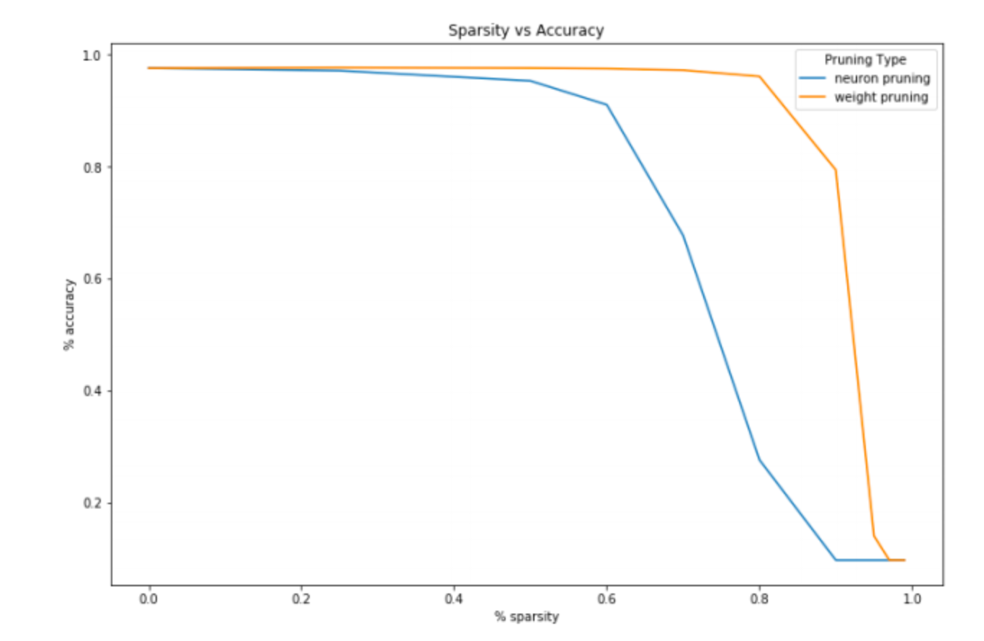
Pruning often Maintains Accuracy

Slide 42
Lottery Ticket Hypothesis
Dense, randomly-initialized, feed-forward. networks contain subnetworks (winning tickets ) that—when trained in isolation—reach test accuracy comparable to the original network in a similar number of iterations.
The winning tickets we find have won the initialization lottery: their connections have initial weights that make training particularly effective.
However, architectures uncovered by pruning are harder to train from the start
They reaching lower accuracy than the original networks

Slide 43
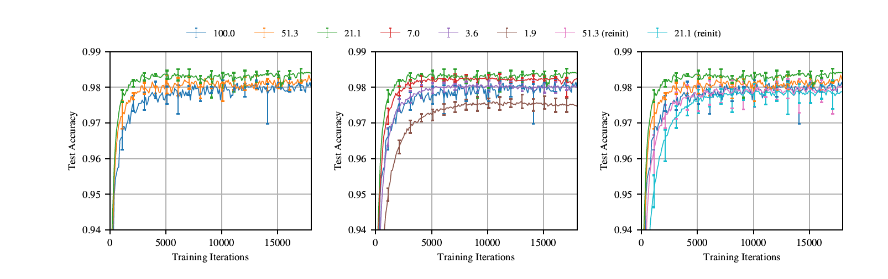
Empirical Evidence

Slide 44
Further reading
Tishby et al. DNNs and Information Bottleneck https://arxiv.org/abs/1503.02406
Frankle & Carbin 2019 THE LOTTERY TICKET HYPOTHESIS: FINDING SPARSE, TRAINABLE NEURAL NETWORKS https://arxiv.org/pdf/1803.03635.pdf
DasGupta & Gupta 2002 https://cseweb.ucsd.edu/~dasgupta/papers/jl.pdf
Visualizing the PHATE of neural networks https://arxiv.org/abs/1908.02831

